Slide 1
Building a Greener NHS
Southdene Patient Participation Group November 2023

Slide 2
Southdene Medical Centre – Greener NHS
NHS England has committed to reducing its direct carbon emissions to 'net zero' by 2040, with most of the reduction by 2030.
We want to do our part to help our patients in a greener, more sustainable way.

Slide 3
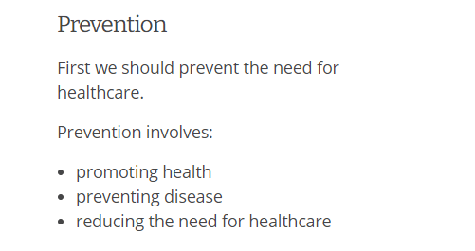

Slide 4
Prevention
Encouraging healthy lifestyles
Vaccinations
Screening, eg for cancer
Regular reviews for patients with long term conditions such as asthma, COPD, diabetes etc

Slide 5
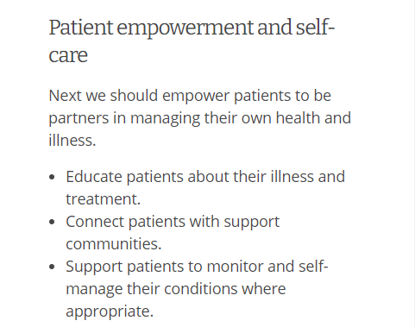

Slide 6
Patient empowerment & Self-care
Diabetes training
Blood glucose monitoring
Asthma care plans & when to increase medication
Self care for minor ailments

Slide 8
Lean Pathways
Medication reviews & stopping unnecessary medication
Reducing antibiotic prescribing

Slide 9
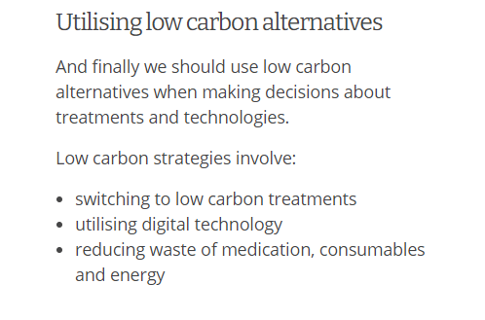

Slide 10
Low carbon alternatives
Greener inhalers
Remote appointments
Reduce medicines waste

Slide 11
Sustainable Quality Improvement
Setting Goals
Improve recycling of plastics in inhalers
Prescribe greener inhalers (Ventolin is 20 times worse than Salamol)
Reduce medicines waste
Increase use of remote & online appointments
Study the system
Respiratory reviews
Medication ordering process
Digital capacity of practice and patients
Design the improvement work
Patient messages about recycling inhalers
Poster about recycling inhalers & joint work with local pharmacies
Change to Salamol instead of generic salbutamol / Ventolin
Explore possibility of video consultations
Increase amount of time allocated to Medication reviews
Measure the impact
Ongoing

Slide 12
Southdene Medical Centre
The climate emergency is also a health emergency, and health care in the UK contributes 5.4% of the UK's carbon emissions.
We need to enhance the health of our current population without compromising the health of future generations, and this means operating within the sustainable boundaries of the planet.
We commit to becoming a greener practice in our prescribing of medications, working towards the following targets:
Patient messages about recycling inhalers
Poster about recycling inhalers & joint work with local pharmacies
Change to Salamol instead of generic salbutamol / Ventolin
Explore possibility of video consultations
Increase amount of time allocated to Medication reviews

